Slide 1
Big Data in Healthcare and Privacy Issues
By Issa Karadsheh

Slide 2
Topics Covered
What is big data in healthcare?
Why is it important?
How is it used?
What is privacy?
What safeguards are there to protect privacy?

Slide 3
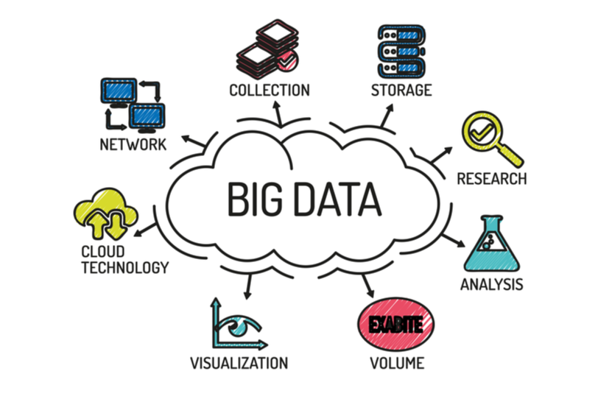
What is Big Data?
A massive amount of information on a given topic.
Includes information that is generated, stored, and analyzed on a massive scale.
It is too vast to manage with traditional information storage systems.

Slide 4

Big Data in Healthcare
Big data sources include patient medical records, hospital records, medical exam results, and information collected by healthcare testing machines.
Biomedical research on public health also provides a large portion of the big data that, if properly managed and analyzed, can serve as meaningful information for patients, doctors, administrators, and researchers alike.

Slide 5
Why is it important?
It can make more informed decisions about treatment and services.
Identify the warning signs of a serious illness before it arises.
Administrators can use key performance indicators and data analytics to make a number of funding and resource allocation decisions.
Big data amassed in health records and Google maps have been used to make critical health maps that highlight underserved locations.

Slide 6
Why is it important? (cont.)
Administrators and providers can use such information to determine where to deploy mobile health clinics and other resources.
Hospitals and other large care facilities can use big data to capture a comprehensive picture of patient experience.
Big data holds the promise of consolidating patient data, allowing for rapid and accurate communication between patients and providers that draws from a patient’s entire health history.

Slide 7

Staffing
It can help with patient predictions for improved staffing.
Shift managers face how many people that they can staff at any given time period.
Putting too many workers runs the risk of having unnecessary labor costs adding up. Too few workers can lead to poor customer outcomes, which can be fatal for patients in that industry.

Slide 8

Assistance Publique-Hôpitaux de Paris
Fours hospitals that are part of the Assistance Publique-Hôpitaux de Paris have been using data from a variety of sources to come up with daily and hourly predictions of how many patients are expected to be ant each hospital.
One of the key data sets is ten years’ worth of hospital admission records, which data scientists crunched using “time series analysis” techniques.
These analyses allowed the researchers to see relevant patterns in admission rates. Then, they could use machine learning to find the most accurate algorithms that predicted future admissions trends.

Slide 9
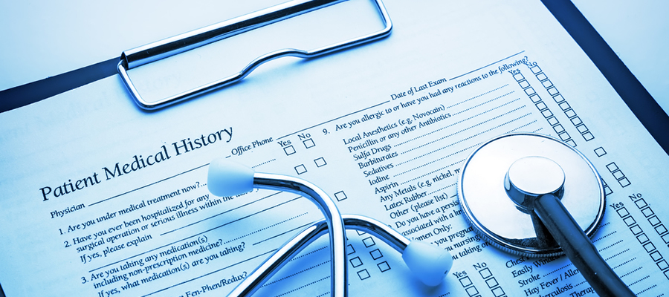
Health Records
Every patient has their own digital record that include demographics, medical history, allergies, laboratory test results, etc.
Records are shared through secure information systems and are available for providers from both private and public sectors.
Every record is comprised of one modifiable file, which means that doctors can implement changes over time with no paper work and no danger of data replication.

Slide 10
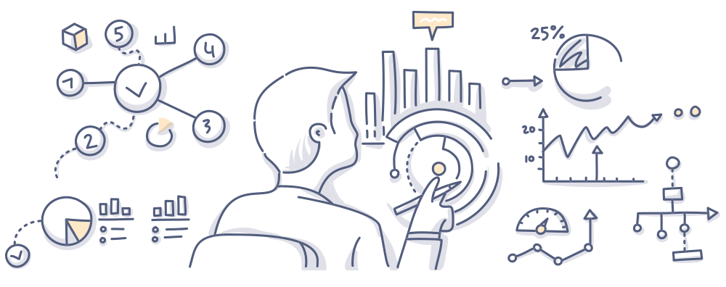
Real-time Alerting
Clinical Decision Support (CDS) software analyzes medical data on the spot, providing health practitioners with advice as they make prescriptive decisions.
Wearables will collect patients’ health data continuously and send this data to the cloud.
Additionally, this information will be accessed to the database on the state of health of the general public, which will allow doctors to compare this data in a socio-economic context and modify the delivery strategies accordingly.

Slide 11
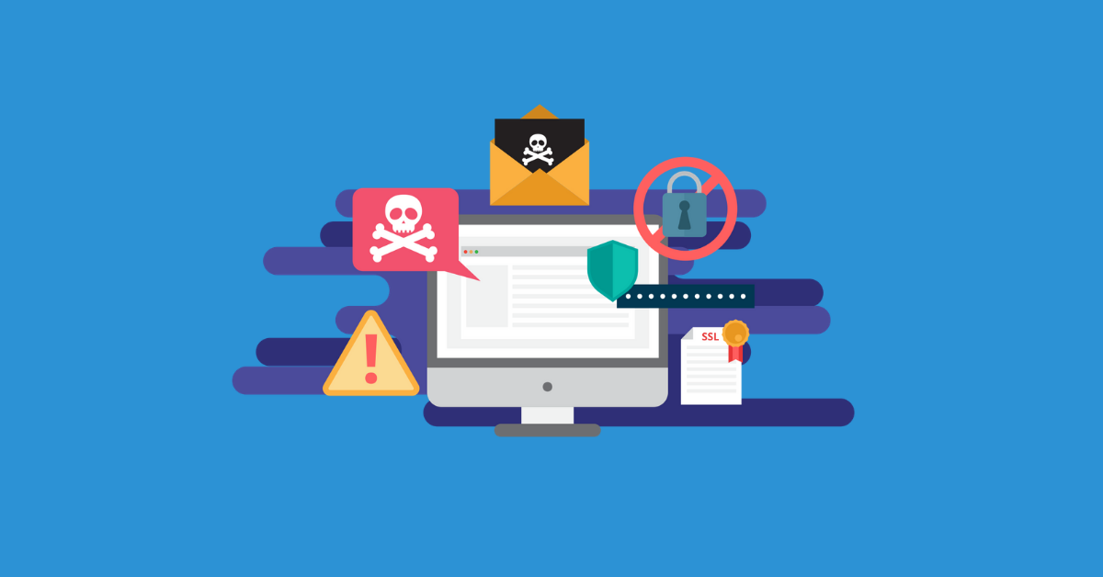
What is Privacy?
Privacy is often defined as having the ability to protect sensitivity information about personally identifiable health care information.
It focuses on the use of governance of individual’s personal data like making policies and establishing authorization requirements to ensure that patients’ personal information is being collected, shared, and utilized in right ways.

Slide 12
Invasion of Privacy
An incident reported in Forbes magazine mentioned that Target corporation sent baby care coupons to a teenage girl unknown to her parents.
This incident impels analytics and developers to consider privacy in big data.
It raised an alarm over patient privacy.

Slide 13
Safeguards

